Slide 1

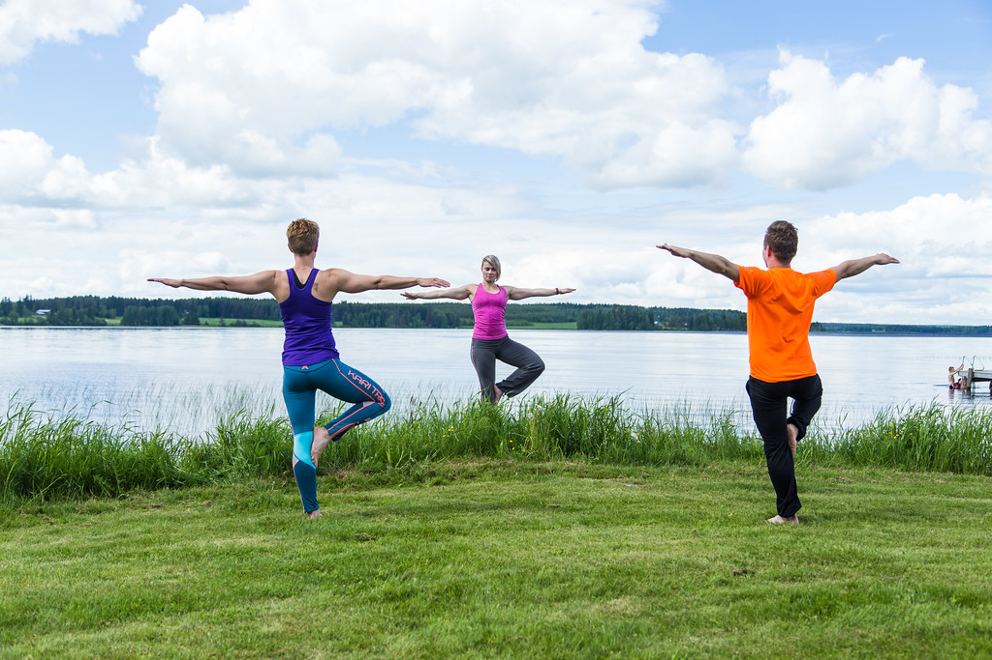
Matawan’s Summer Lake Yoga 2020 with Lily
Class Limited to 24
Spots to be marked for Social Distancing
Every Saturday Morning 8:30- 9:30 AM
Starting June 6th – August 29th
No class July 4th
$60.00 check made payable to Borough of Matawan
Must be registered with Department of Recreation
Name:________________________________________________________
Email:________________________________________________________
Check No:#____________________________________________________
Please drop off registration and check in an envelope marked Attention Recreation at 201 Broad Street drop box before June 5th
NO CASH
If classes are rained out – no inside classes due to social distancing limit of 10
Rained Out class will be made up on Sunday
Any questions, please email recreation@matawanborough.com
Registration forms www.matawanborough.com

